Slide 1



UNIT 4
LESSON 14
Q for a question
Part 5

Slide 2
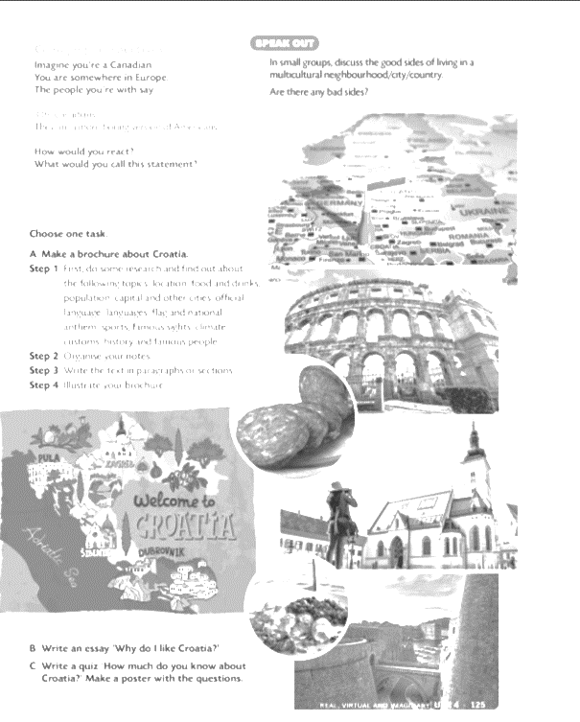
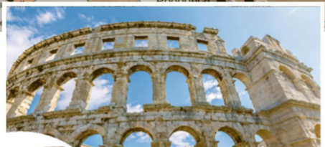
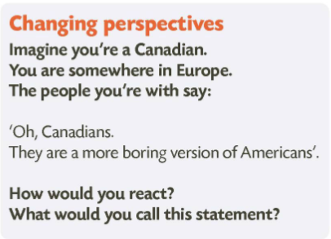
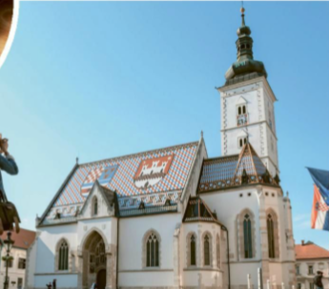
Start with the brochures/posters/quizzes/essays or presentations about Croatia you prepared for homework.
Have a display/play the quizzes/read your essays or give presentations.
stereotypes
a set idea that people have about what someone or something is like, especially an idea that is wrong
How do you see Americans and how would you describe them?
Why do you think so? What influences the way you see Americans?
Very often we form an image of something or somebody as a result of media influence and that needn’t be true. To get rid of stereotypes, we need to learn about something/somebody.

Slide 3
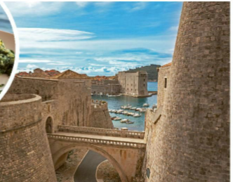
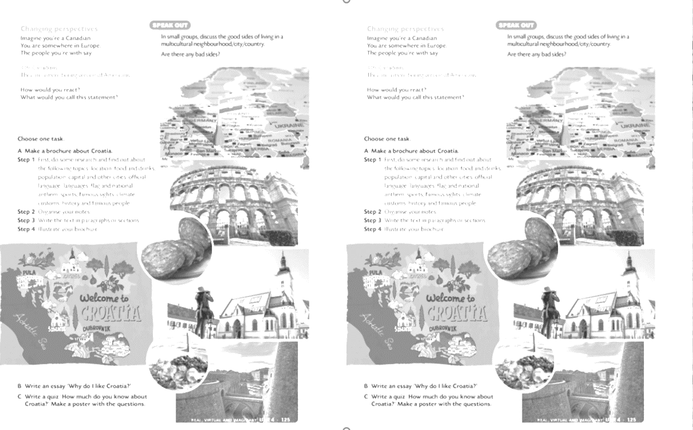
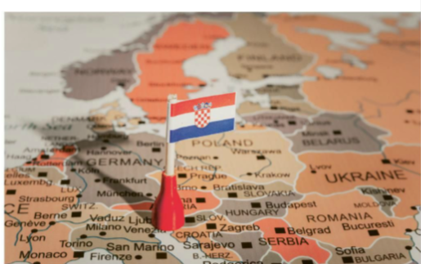
How would you describe Croats/people from Croatia?
How do you think foreigners see us?
It’s important to be tolerant and open, and not to generalise things.

Slide 4
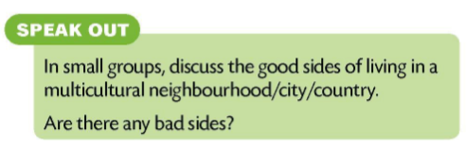
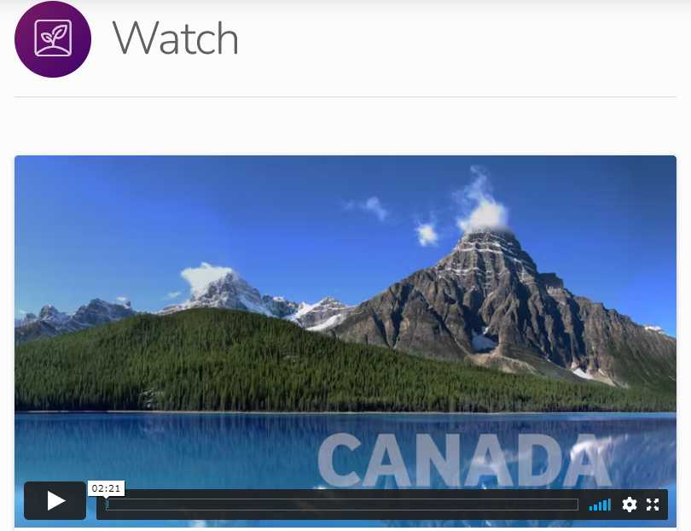


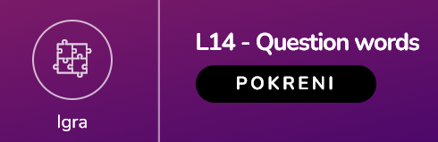



Slide 5
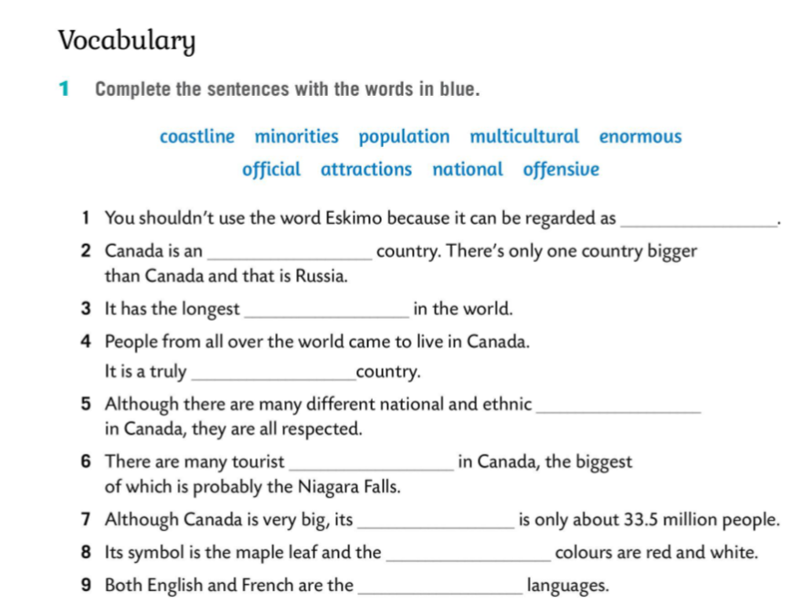
offensive
enormous
costline
multicultural
minorities
attractions
population
national
official

